Slide 1

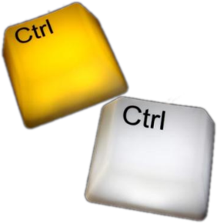

Test Progress Monitoring and Control
Stoimen Stoimenov
QA Engineer
SitefinityLeads, SitefinityTeam6
Telerik QA Academy

Slide 2


Table of Contents
Test Progress Monitoring
Test Reporting
Test Control

Slide 3
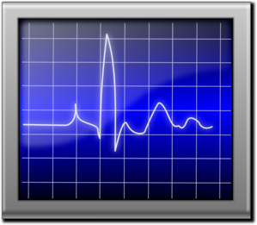
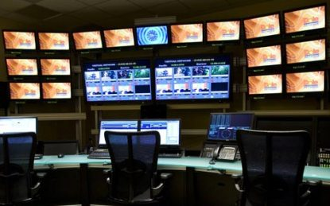
Test Progress Monitoring

Slide 4
Purposes of Test Monitoring
What is test monitoring useful for?
Feedback for the team and the test manager
Visibility about test results
Measuring the status of the testing, test coverage and test items
Determining whether the work is done
Gathering data
For decision making
For use in estimating future test efforts

Slide 5

Gathering Data
How do we gather data for test monitoring?
Manually
Using documents, spreadsheets and simple databases
For small projects
Using automated tools
For large teams, distributed projects and long-term test efforts

Slide 6
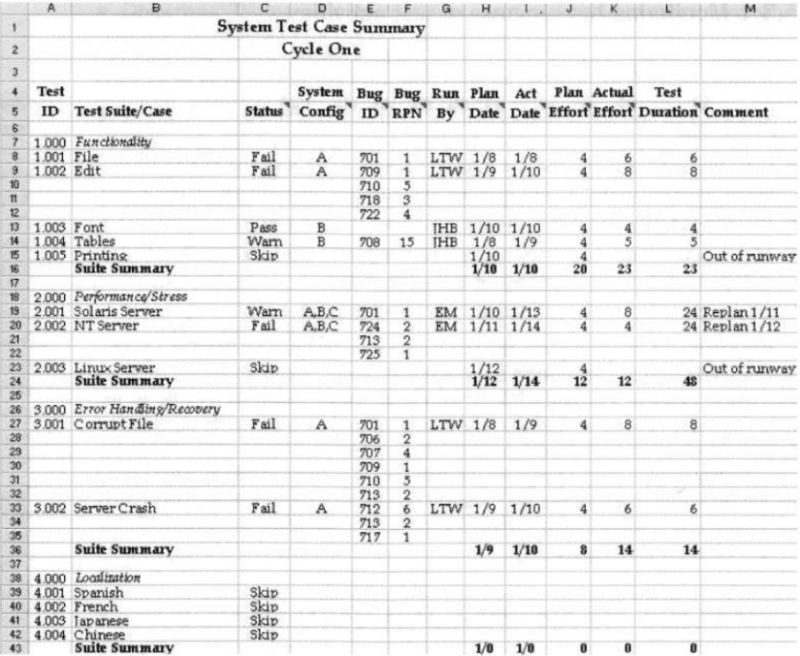
Test Log Templates
Demo
Notes:
See: Foundations of Software Testing ISTQB Certification - chapter 5.3.1 Monitoring the progress of test activities

Slide 7
Some Other Metrics
Other common metrics for test progress monitoring include:
Completion of test environment preparation
Extent of test coverage achieved
Status of the testing
Compared to various test milestones
Economics of testing
E.g., costs and benefits of continuing test execution

Slide 8
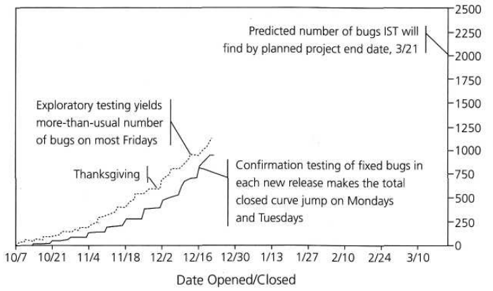
Total Number of Defects Found/Closed Chart
A chart could be used to manage the number of defects found and fixed
According to the planned test period end date and the planned number of defects

Slide 9
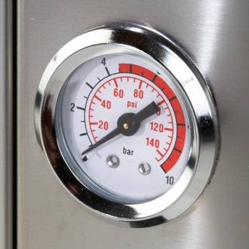
Failure Rates or Defect Density
Charts can also be used to show failure rates or defect density
When reliability is a key concern
Being more concerned with the frequency with which failures are observed
How many defects are causing the failures is then less important

Slide 10

Use Measurement With Care!
Avoid using defect metrics alone
It is possible to achieve a flat defect find rate
Fixing all the known defects by stopping any further testing
Deliberately impeding the reporting of defects
Allowing programmers to reject, cancel, or close defect reports without any independent review

Slide 11

Reporting Test Status

Slide 12
Reporting Test Status
What is reporting test status about?
Communicating our findings to other project stakeholders
Helping them understand the results of a test period
Reports can be used to support conclusions, recommendations, and decisions

Slide 13
How Do We Report?
Test status can be reported in a variety of ways – according to:
Preferences of the testers and stakeholders
Needs and goals of the project
Regulatory requirements
Time and money constraints
Limitations of the tools available for test status reporting

Slide 14

Test Status Reports
Demo

Slide 15

Planning for Test Reporting
The means for test status reporting should be considered early
During the test planning and preparation periods
Effective and efficient metrics should be chosen

Slide 16

Common Considerations
How will you assess:
Adequacy of the test objectives
Adequacy of the test approaches
Effectiveness of the testing

Slide 17

Test Summary Report
Test summary report
Created either at a key milestone or at the end of a test level
Describes the results of a given level or phase of testing

Slide 18


Test Summary Report
Demo

Slide 19

Test Control

Slide 20

Test Control
Testing sometimes gets delayed according to the test schedule
Test control is about guiding and corrective actions
Trying to achieve the best possible outcome for the project

Slide 21
What Can Be Done?
What can be done to correct a delay?
Additional test resources can be requested
E.g., personnel, workstations, equipment, and tools
The test plan itself can be adapted
Test cases with low priority can be omitted
Test cases with multiple variants can be run in just a single variant

Slide 22

Communicating Changes
Changes to test plan must be communicated clearly
Changes in the test plan may increase the release risk
The test manager has to document and communicate every change in the plans

Slide 23
Test Progress Monitoring and Control
?
?
?
?
?
Questions?
?
?
?
?
?
?

